Slide 1

Image compression app with Python
Playing around with Python functionalities to get a grip of how powerful this programming language actually is
Antoneta Gjeka
Ericsson Internal
07/11/2024

Slide 2
Problem & Solution
Initial problem:
Professional photos taken at various events (on-site) -> large sized files
Photos uploaded directly to the Sharepoints, without being sized down beforehand -> overload, no more storage space available
Solution:
Development of an app (in Python) that compresses the photos in advance before they are uploaded to the sharepoints
Intuitive & simple to use, can be installed on the local device

Slide 3
Assignment specification
Folder selection: Option to select a folder with images for compression
Batch image compression: Ability to compress all images in a selected folder, supported formats must include: .jpg, .jpeg, .png, .gif, .bmp
Save location: Ability to choose a destination folder for compressed images
File size reduction: Compress images to reduce file size while maintaining acceptable quality
GUI Interface: User-friendly graphical interface for easy interaction
Status updates: Display real-time status during the compression process
Size comparison: Visual representation (graph) of the storage saved after compression
One-click operation: A single button to start compressing images

Slide 4
But first, why Python?
Extensive libraries: Python offers powerful image processing libraries like PIL(Pillow) and OpenCV, which provide easy-to-use functions (compressing, resizing, manipulating images)
Cross-platform compatibility: Python applications can be run on multiple platforms (Windows, Linux, macOS) -> highly versatile
Ease of use: Python’s simple syntax makes it ideal for quickly developing image compression tools
GUI integration: Tkinter enables easy creation of user-friendly interfaces with minimal code
Scalability: Python supports batch processing, handling multiple image compressions efficiently
Open-source & Support: Python’s large community offers abundant resources for solving issues and optimizing compression

Slide 5
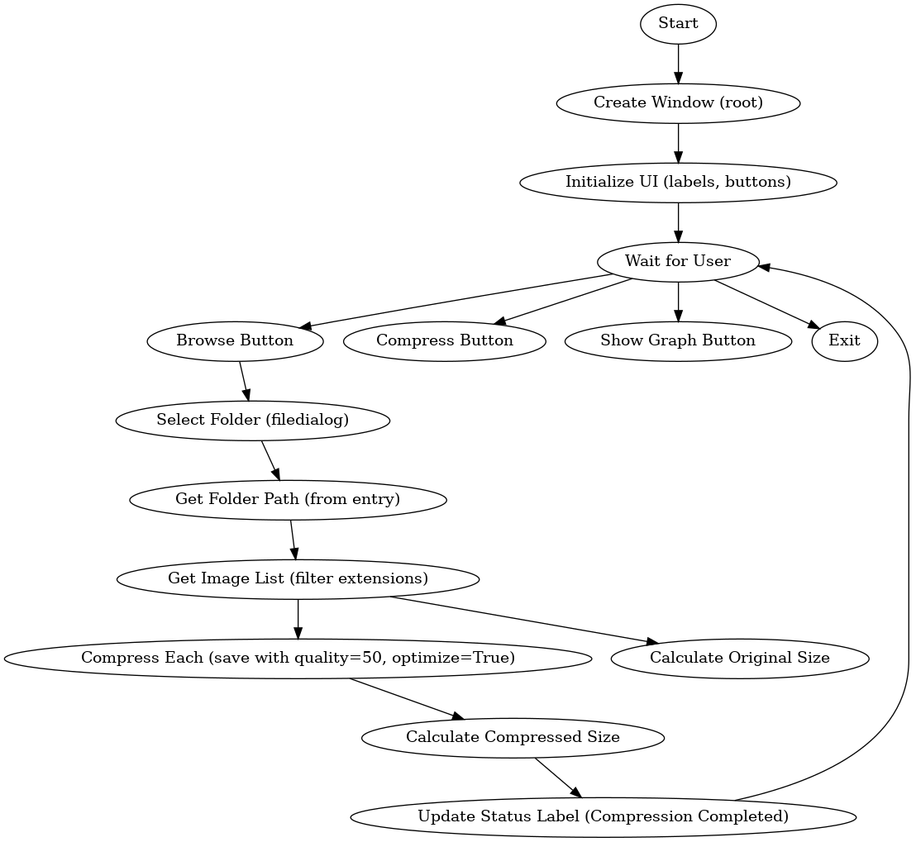
Structural breakdown of program
The window pops up, select the image folder to be compressed
Then select the folder in which the compressed photos are to be saved
After the folder has been selected, compression is started. The current status of the compression is displayed
After successful compression, a success window is shown
You can also display the difference in size between the two folders graphically at the end

Slide 6
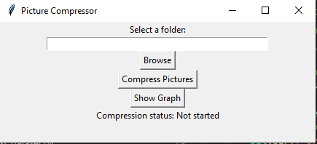
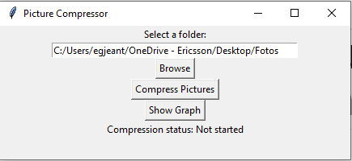
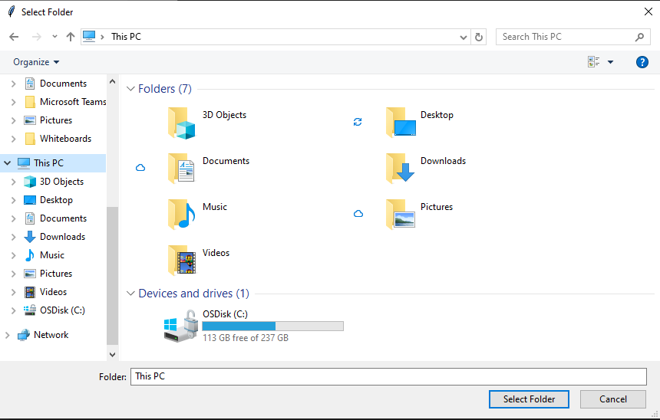
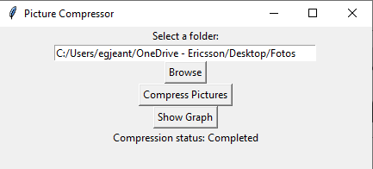
How to use the app
Run the app (.exe file on PC)
The following window should pop up
Click “Browse” to search for the image folder that needs to be compressed
After selecting the folder, “Compress Pictures” should be clicked, another window shows up – here you have to select the folder where the compressed images should be saved
Afterwards, the compression process will start automatically. Compression status should be completed, like shown on the figure below:

Slide 7
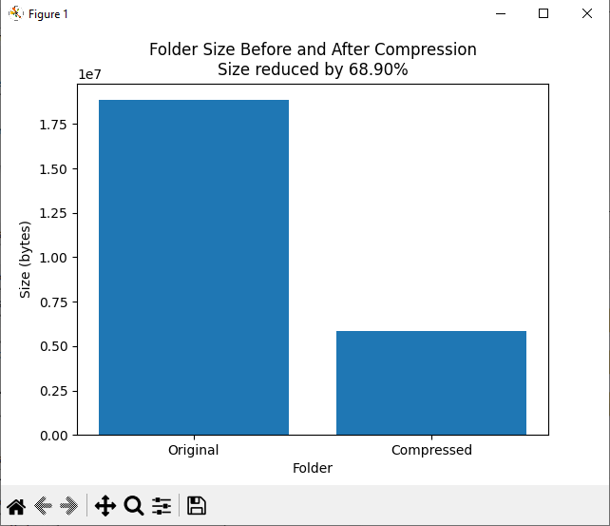
Results

Slide 8

Possible improvements
The ability to select multiple images, not just folders
Improvement of the GUI, making it more user-friendly & modern
Optimization of the code, faster execution
Adding extra functionalities (user can decide how much the photos should be compressed)

Slide 9
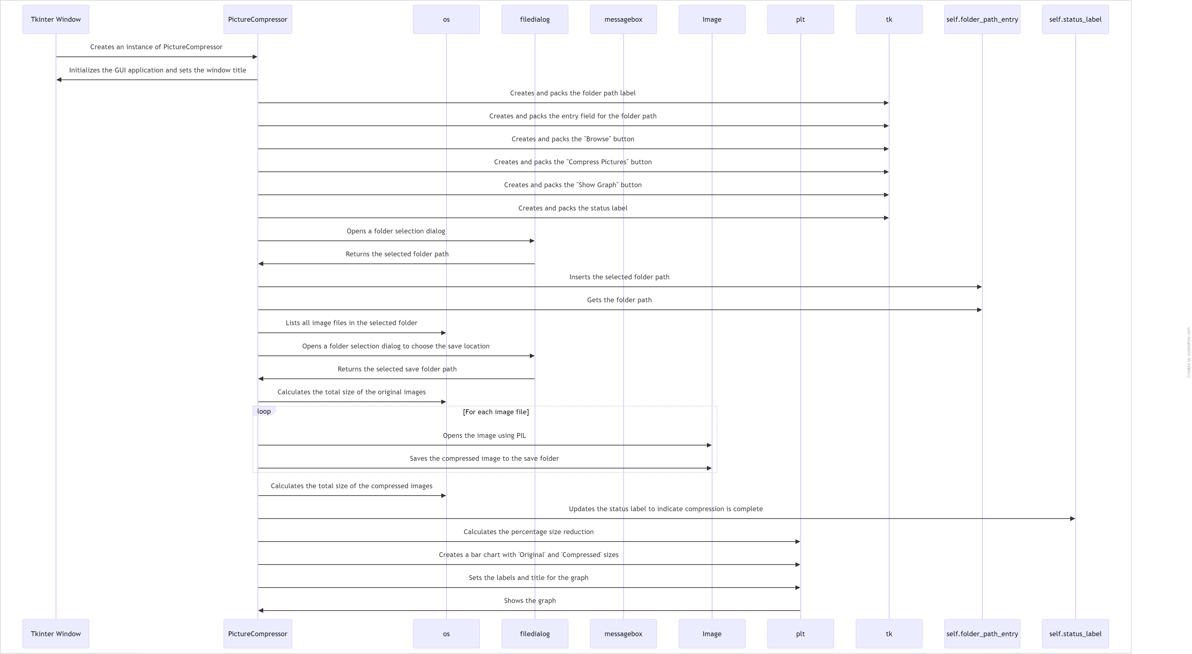
Sequence diagram

Slide 10
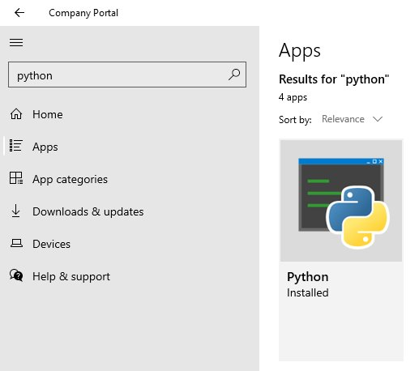
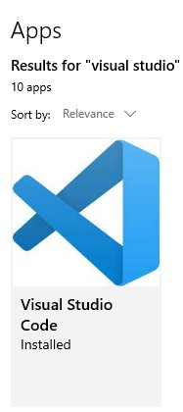
Developer setup – what tools are needed
IDE to write, run and debug code
(here: Visual Studio Code)
Gerrit – allows multiple developers to
work parallelly.
Libraries

Slide 11
Thanks for your attention! Any questions?

